Slide 1

Introduction to CSS
Selectors, Properties, and Box Model

Slide 2
What is CSS?
CSS stands for Cascading Style Sheets
It is used to style and design HTML web pages
CSS controls:
Layout (positioning of elements)
Colors (text, background, borders)
Fonts & Text styling
Spacing and sizes (margins, padding, width, height)
CSS separates content (HTML) from presentation (design)

Slide 3
Types of CSS
Inline CSS
Written directly inside an HTML element using the style attribute
Internal CSS
Written inside <style> tag in the HTML <head>
External CSS
Written in a separate .css file and linked using <link> tag

Slide 4
CSS Priority (Order of Precedence)
If multiple styles are applied, CSS decides which one to apply based on priority:
Inline CSS (highest priority)
Internal CSS
External CSS (lowest priority)
The rule with higher specificity wins
The last rule written (if same specificity) overrides previous ones
!important overrides all styles

Slide 5
CSS Selectors, Priority of Selectors
When multiple selectors target the same element:
Inline styles (style="") → Highest
ID selector (#id)
Class selector (.class) / Attribute selector
Type selector (p, h1, div)
Universal selector (*) → Lowest

Slide 6
Text & Font Properties
color → text color
background-color → background color
font-size → size of text (px, em, rem, %)
font-family → typeface (Arial, Verdana, sans-serif)
line-height → space between lines of text
text-align → left, right, center, justify
text-decoration → underline, overline, none
text-transform → uppercase, lowercase, capitalize

Slide 7
CSS Box Model
Content → actual text, image, or data
Padding → space between content & border
Border → surrounds padding and content
Margin → space between the element and other elements

Slide 8
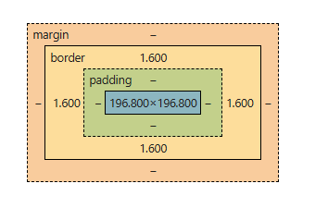
Box

